Slide 1
CHAPTER 5
WIRELESS COMMUNICATIONS

Slide 2
Introduction
Wireless
  Communications system in which electromagnetic waves carry a signal through atmospheric space rather than along a wire
  Most systems use radio frequency (RF, which ranges from 3 kHz to 300 GHz) or infrared (IR, which ranges from 3 THz to 430 THz) waves
  IR products do not require any form of licensing by the FCC

Slide 3
Timeline of Major Developments
Mobile Telephone System (MTS)
  Introduced in 1946
  Simplex (one-way transmission) and manual operation
Improved Mobile Telephone System (IMTS)
  Introduced in 1969 using a 450 MHz band
Advanced Mobile Phone Service (AMPS)
  Introduced in 1983
  First system to employ a “cellular” concept

Slide 4
Cellular Topology
Cellular network:
  Series of overlapping hexagonal cells in a honeycomb pattern
Cellular network components
  Base Station:Transmitter, Receiver, Controller, Antenna
  Cell: Base station’s span of coverage
  Mobile Switching Center: Contains all of the control and switching elements to connect the caller to the receiver, even as the receiver moves from one cell to another

Slide 5
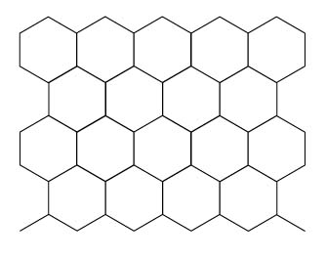
Cellular Network Topology

Slide 6
Personal Communications Systems (PCS)
PCS is also called Personal Communications Networks (PCN)
Goal of PCS is to provide integrated voice, data and video communications
Three categories of PCS:
  Broadband: cellular and cordless handsets
  Narrowband: enhanced paging functions
  Unlicensed: allows short distance operation

Slide 7
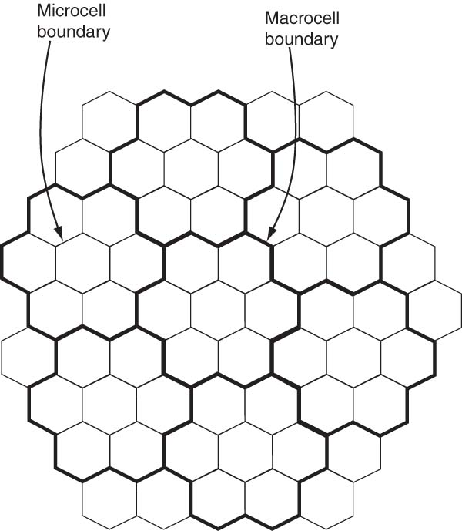
Hierarchical Cell Structure
Key features of PCS
  Variable cell size
  Hierarchical cell structure (picocell, microcell, macrocell, supermacrocell)

Slide 8
Analog Access
Analog Cellular Systems
  First generation system
  Based on FDMA (Frequency Division Multiple Access), where frequency band is divided into a number of channels. Each channel carries only one voice conversation at a time.
  AMPS operates on 800 MHz or 1800 MHz
  Advantages:
    Widest coverage
  Limitations:
    Inadequate to satisfy the increasing demand
    Poor security
    Not optimized for data

Slide 9
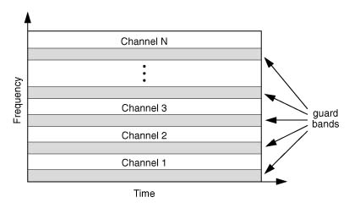
FDMA

Slide 10
Digital Access
D-AMPS (Digital-AMPS)
TDMA (Time Division Multiple Access)
CDMA (Code Division Multiple Access)
Digital wireless technologies provide greater system capacity.

Slide 11
TDMA
TDMA
  Second generation system
  Enables users to access the whole channel bandwidth for a fraction of the time, called slot, on a periodic basis
  Has applications in satellite communications
  Advantages
    Improved capacity

Slide 12
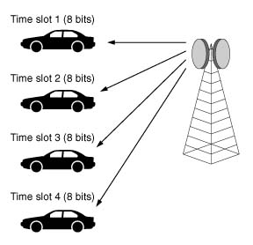
TDMA

Slide 13
CDMA
CDMA
  Third generation system
  Separates users by assigning them digital codes within a broad range of the radio frequency
  First technology to use soft-handoff
  Employs spread spectrum technique
  Advantages
    Improved capacity, coverage, voice quality, and immunity from interference

Slide 14
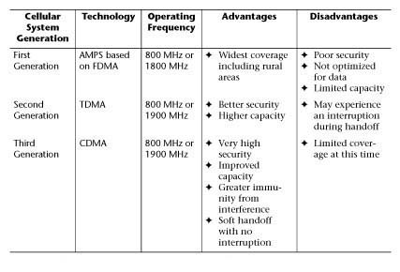
An Overview of Cellular Technologies

Slide 15
Spread Spectrum Technique: FHSS
Frequency Hopping Spread Spectrum (FHSS)
  Resists interference by jumping rapidly from frequency to frequency in a pseudo-random way
  Advantage
    Increases the total amount of available bandwidth through the assignment of multiple hopping sequences within the same physical area
    More flexible than DSSS
  Application
    In large facilities especially with multiple floors

Slide 16
Spread Spectrum Technique: DSSS
Direct Sequence Spread Spectrum (DSSS)
  Resists interference by mixing in a series of pseudo-random bits with the actual data
  Advantage
    If bits are damaged in transmission, the original data can be recovered as opposed to having to be retransmitted
  Application
    Is substituted for point-to-point or multi-point connectivity to bridge LAN segments
  Limitation
    Roaming capabilities are less robust

Slide 17
Spread Spectrum Technique: CDPD
Cellular Digital Packet Data
  Allows for a packet of information to be transmitted in between voice telephone calls
  Enables data specific technology to be tacked onto existing cellular telephone infrastructure

Slide 18
Wireless Applications
Cellular Phone
  High mobility and narrow bandwidth (20 to 30 kHz)
Cordless Phone
  Low mobility and narrow bandwidth (20 to 30 kHz)
Wireless LAN
  Low mobility and high bandwidth (typically 10 Mbps)
  Wireless Application Protocol (WAP) is a standard for wireless data delivery, loading web pages, and navigation

Slide 19
Bluetooth
Bluetooth is a uniting technology that allows electronic devices (like computers, headphones, keyboards) to make their own connections
  Originated in 1994 when Ericsson formed the Bluetooth Consortium with IBM, Intel, Nokia, and Toshiba
  Operates in the unlicensed 2.4 GHz band, an open frequency band in most countries, ensuring worldwide compatibility
  Open standard that works at the two lower layers of the OSI model
  Includes application layer definitions for product developers to support data and voice applications
  Uses FHSS technique
Bluetooth addressing
  48-bit address is divided into 24-bit OUIs and 24-bit device address

Slide 20
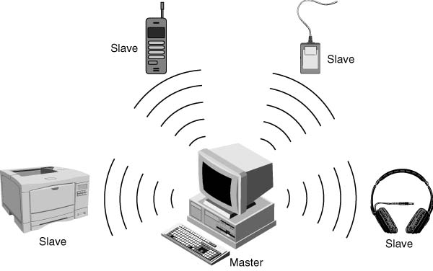
Bluetooth piconet: Master/Slave setup

Slide 21
Transmission Speed
Overheads = Data Rate – Throughput
Data rate: raw transmission speed
Overhead: transmission rules and protocols
Throughput: capacity available to the user

Slide 22
Wireless LANs
Advantages of wireless LANs
  Highly beneficial for mobile professionals
  Real-time communications improves efficiency, and productivity
  Recommended for hard-to-wire sites
  Solve problems like cabling restrictions and frequent reorganizations
Disadvantages of wireless LANs
  Less functional and offer limited coverage
  More expensive to install than wired LANs
  Higher error rates due to interference from outside signals

Slide 23
Wireless LAN Specifications
IEEE 802.11 Standards for Wireless LANs
  802.11 standards provide for interoperability between different manufacturers’ equipment
  Mobility is handled at Layer 2, especially the MAC sub-layer
  802.11-compliant solutions consist of:
    Access points (wireless transceivers), and
    Wireless PC (PCMCIA) cards

Slide 24
IEEE 802.11 Standards
802.11a
  Uses the 5 GHz spectrum
  Provides maximum throughput of 54 Mbps
  Accommodates more users, but has shorter operating range when compared to 802.11b
802.11b
  Uses the 2.4 GHz unlicensed radio band
  Typical throughput of 11 Mbps
802.11g
  Same high speed as 802.11a and uses the 2.4 GHz band so it is backwards compatible with 802.11b

Slide 25
Microwave LANs
Microwave LANs utilize signals above 30 MHz, which requires licensing by the FCC
Microwave LAN components
  Modem, RF unit, Antenna
Restrictions on Microwave LANs
  Line-of-sight
  Antennas should not be more than 30 miles apart
  Communications are affected by atmospheric conditions such as rain and humidity
Applications
  LAN-to-LAN connection

Slide 26
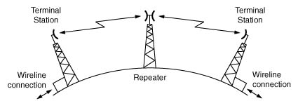
Microwave Relay System

Slide 27
Radio LANs
Types of Radio LANs
  Narrow-Band Radio LAN
    Have a cost advantage
    Lower data throughput
    Applications in warehousing and industrial environments
  Spread-Spectrum Radio LAN
    Highly reliable and secure
    Signal is attenuated by brick and concrete, and metal objects
    Applications in office environments
Wireless LAN technology components
  PCMCIA cards and roaming-enabled access points

Slide 28
Infrared (IR) LANs
Types of IR systems
  Line-of-sight
    Point-to-point high-speed connectivity
    Require line-of-sight
  Reflective
    Bounce signals off walls, ceilings and floors
  Scatter
    Use diffused signals
    Low-speed but better coverage

Slide 29
Broadband Wireless Systems
Wireless Local Loop (WLL)
  Used in place of wire-line local loop
  Broadband capability (can carry voice, data, and video)
Local Multipoint Distribution System (LMDS)
  Requires line-of-sight
  Supports transmission over short distances
  High Capacity, High Cost
Multichannel Multipoint Distribution System (MMDS)
  Wider coverage
  Low Capacity, Low Cost

Slide 30
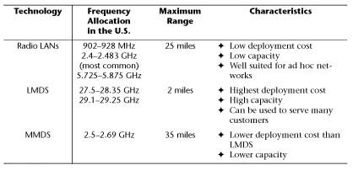
Comparison Table:
Broadband Wireless Technologies

Slide 31
Satellite Communications
Components of a satellite system
  Satellite Earth Station
    Establishes and maintains continuous communication links with all other earth stations in the system
  Satellite
    A wireless transceiver placed in orbit around the earth
Each satellite band is divided into separate portions
  Uplink (earth to space)
  Downlink (space to earth)
Applications of satellite communications
  Preferred in locations where high-speed wire connections are not an option for geographic or financial reasons
  Navigation, Weather monitoring, and Broadcasting

Slide 32
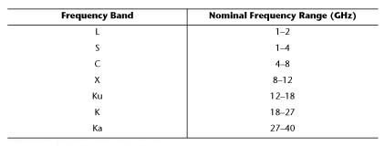
Satellite Frequency Allocations for Various Applications

Slide 33
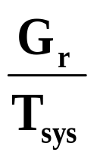
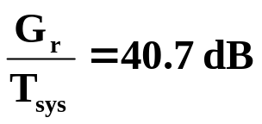
Satellite Communications Parameters
Figure of Merit =
G_{r} = receiver antenna gain (dB)
T_{sys} = system noise temperature
Standards for INTELSAT systems have set the figure of merit to be equal or higher than 40.7 dB

Slide 34
Geosynchronous Satellite (GEO)
The rotational period of a GEO matches that of the Earth and its orbit is without inclination
GEO is both geosynchronous and geostationary
GEOs must orbit the equator at an altitude of 22,237 miles
Use the Ku-band (12 to 14 GHz) frequencies for transmission, but Ka-band (27 to 40 GHz) is also practical
Compared to Ku-band, Ka-band makes interference less likely, reduces power consumption and antenna size
GEOs have a large footprint (about 40% of the Earth)
Mainly used for international and regional communications
Shortcoming is latency (about 240 ms)

Slide 35
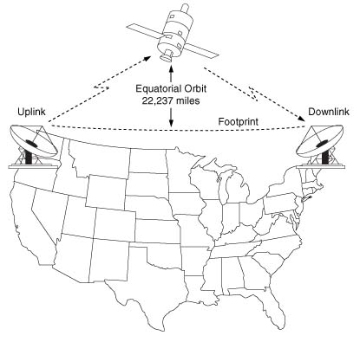
GEO’s Footprint is about 40% of the Earth’s Surface

Slide 36
Global Positioning System (GPS)
GPS is a world-wide radio navigation system funded by the US Department of Defense
GPS is formed by a constellation of 24 satellites at 11,000 mile altitude
Satellites repeat the same track and configuration over any point approximately each 24 hours

Slide 37
GPS Specifications
Six orbital planes are equally spaced and inclined at 55º with respect to each other, which provides between five and eight satellites visible from any point on the earth
Each satellite has its own pseudo-random code so all GPS satellites can use the same frequency without jamming
GPS receiver on earth measures distance by timing, but since its timing is not as accurate as an atomic clock, it must make four simultaneous measurements

Slide 38
LEO and MEO Satellites
Characteristics of LEO (Low Earth Orbit) Satellites, and MEO (Medium Earth Orbit) Satellites
  The system consists of a large fleet of satellites, each in a circular orbit at a constant altitude
  They are not geostationary
  Can have problems with jitter or variable latency
  MEOs operate from an elevation between 1,800 and 6,500 miles while LEOs operate from an elevation between 500 and 1,000 miles. Therefore, fewer MEOs are sufficient to cover the globe.

Slide 39
International Wireless Communications
3G systems combining terrestrial and satellite communications are under development
UMTS (Universal Mobile Telecom System) and IMT-2000
  Based on W-CDMA (Wideband-CDMA) for wide-area applications and TD-CDMA for low-mobility indoor applications
GSM (Global System for Mobile communications)
  2G system based on TDMA
  Operates at 1900 MHz

